Slide 1
Part 1: Break the eBay website into a set of use cases, and make a list of their names. Search for items Browse categories View item details Buy an item Sell an item Sign up for an account Log in to an existing account

Slide 2
Part 2: Construct low level use case text for the basic course and the alternate courses of each use case – and write the use case text below the name of the use case.

Slide 3
Use Case 1: Search for items Basic Course: User enters a keyword in the search box. The website shows a list of items that match the keyword. User can sort the results by various criteria such as price or location. User selects an item from the list to view its details. Alternate Course: No matching results The website displays a message saying that no results were found for the keyword entered. The user can try a different keyword or browse categories.

Slide 4
Use Case 2: Browse categories Basic Course: User selects the "Browse Categories" option from the website menu. The website displays a list of categories. User can select a category to view subcategories and items within that category. User selects an item to view its details. Alternate Course: No subcategories If the selected category has no subcategories, the website displays a list of items within that category. User selects an item to view its details.

Slide 5
Use Case 3: View item details Basic Course: User selects an item from a search or browse results page. The website displays details about the item such as title, description, and price. User can view images of the item. User can view seller information and feedback. User can place a bid or buy the item. Alternate Course: Item is no longer available The website displays a message saying that the item is no longer available. User can go back to the search or browse results page.

Slide 6
Use Case 4: Buy an item Basic Course: User selects the "Buy" option on an item page. The website displays a purchase form where the user can enter shipping and payment information. User confirms the purchase. The website shows a confirmation message. Alternate Course: Payment is declined The website displays a message saying that the payment was declined. User can enter a different payment method.

Slide 7
Use Case 5: Sell an item Basic Course: User selects the "Sell" option on the website menu. The website displays a form where the user can enter details about the item. User uploads images of the item. User sets a price and shipping options. User confirms the listing. The website shows a confirmation message. Alternate Course: Invalid listing details The website displays an error message indicating which field(s) need to be corrected. User corrects the invalid field(s) and confirms the listing.

Slide 8
Use Case 6: Sign up for an account: Basic Course: User selects "Sign Up" button on the website User fills out necessary information (name, email, password, etc.) User selects "Create Account" button website confirms account creation and directs user to the login page Alternate Course: User selects "Sign Up with Google/Facebook" button website prompts user to log in to their Google/Facebook account website uses user's Google/Facebook information to create an eBay account website confirms account creation and directs user to the login page

Slide 9
Use Case 7: Log in to an existing account: Basic Course: User enters their email and password website verifies user information and logs user in website directs user to their account page Alternate Course: User selects "Log in with Google/Facebook" button website prompts user to log in to their Google/Facebook account website verifies user information and logs user in website directs user to their account page

Slide 10
Part 3: Construct a GUI prototype for the eBay website, using the use case text from Part 2.

Slide 11
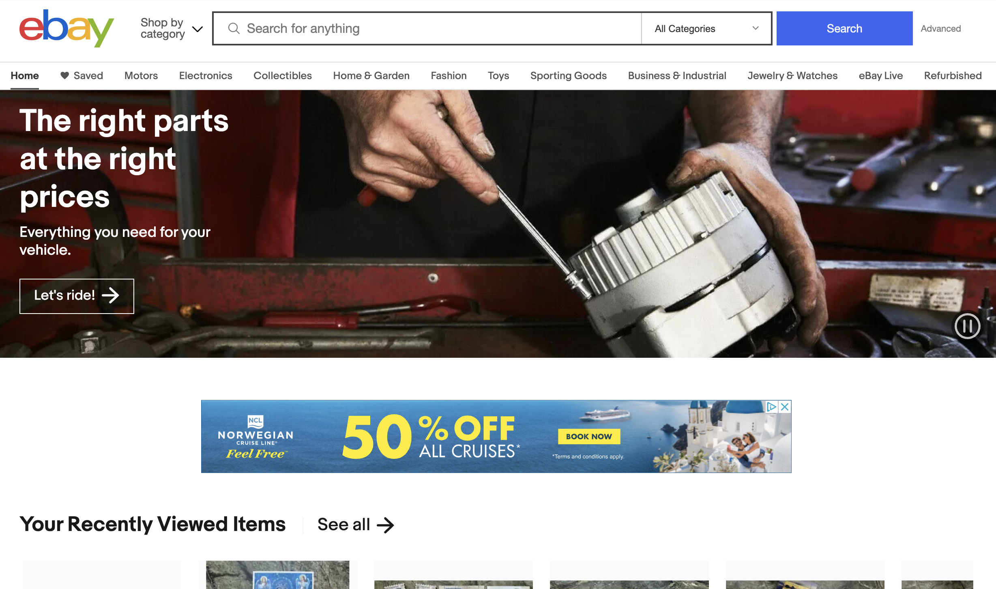
Use Case 1: Search for items

Slide 12
Use Case 2: Browse categories

Slide 13
Use Case 3: View item details

Slide 14
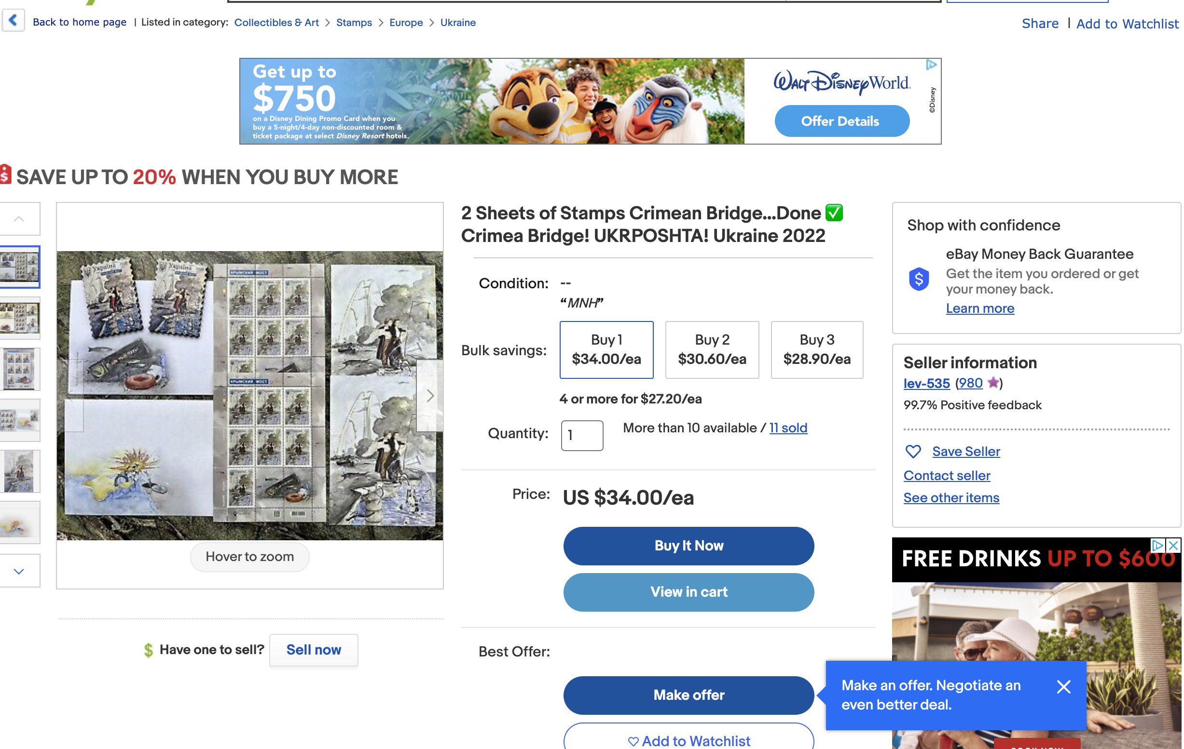
Use Case 4: Buy an item

Slide 15
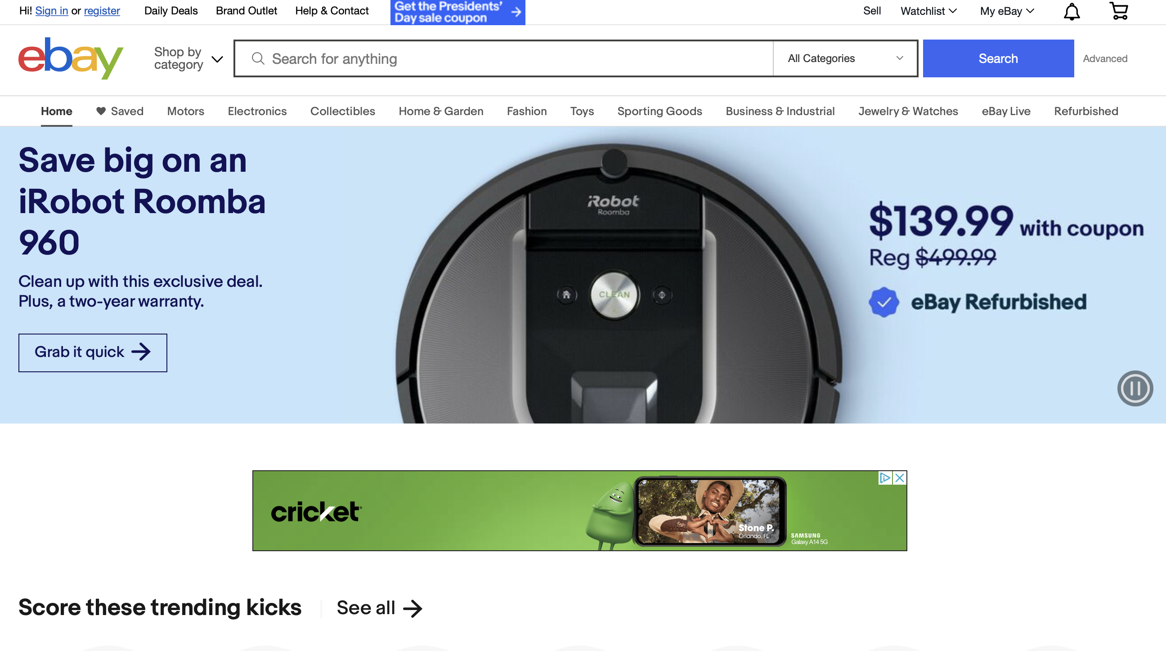
Use Case 5: Sell an item

Slide 16
Use Case 6: Sign up for an account:

Slide 17
Use Case 7: Log in to an existing account:

